Slide 1
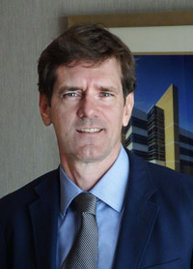
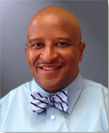
Dr. Thomas E. Dobbs
Dr. Victor Sutton
Dr. Jerryl Briggs

Slide 2
PRESENTERS
Dr. Thomas Dobbs
State Health Director
Dr. Victor Sutton
Director of Preventive Health& Health Equity
Dr. Jerryl Briggs, Sr.
President – MVSU
Dr. Kathie Stromile Golden
Provost & VP of Academic Affairs, Moderator

Slide 3
WHAT IS COVID19?
COVID-19 is a new respiratory virus, first identified in Wuhan, China, that causes flu-like illness ranging from mild to severe, with symptoms of fever, coughing, fatigue and difficulty breathing. Like the flu, COVID-19 is thought to spread person-to-person by close contact (within 6 feet) and by coughing or sneezing. Other possible routes of transmission may include touching surfaces contaminated by the virus.

Slide 4
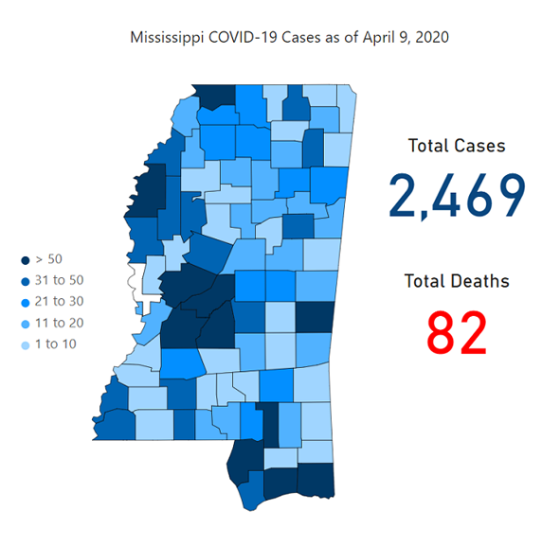

Slide 5
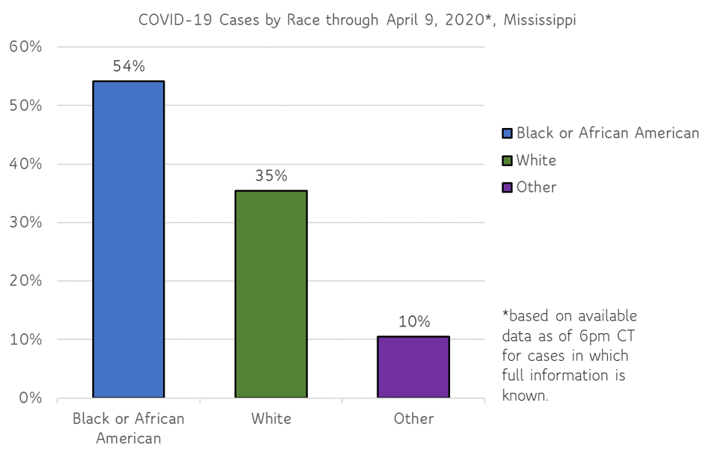

Slide 6
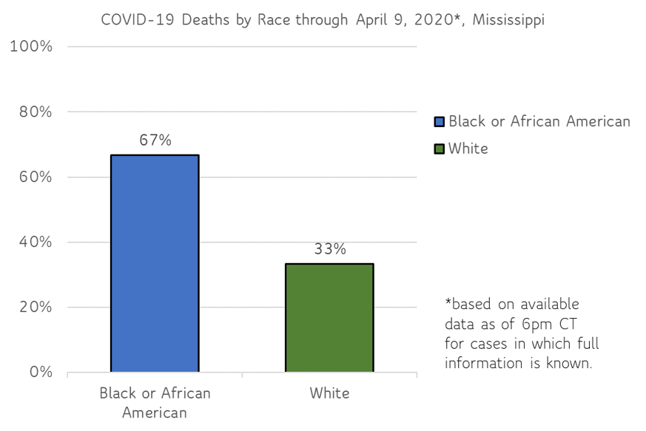

Slide 7
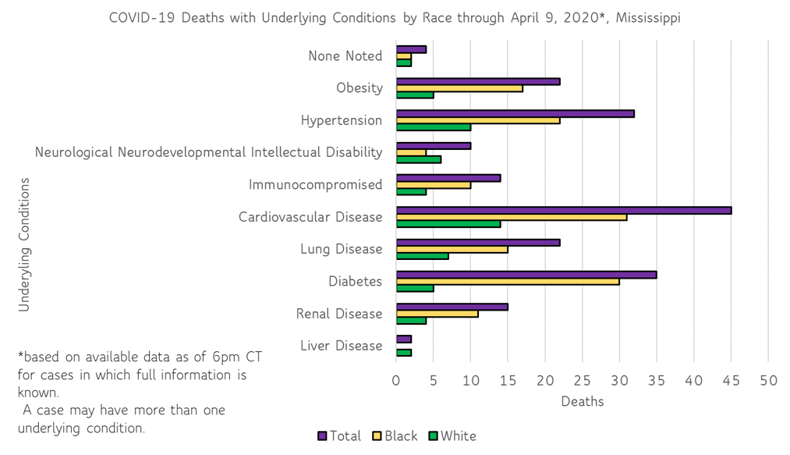

Slide 8
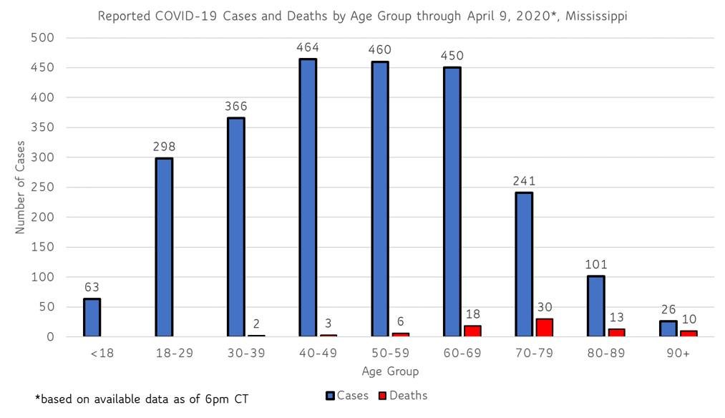

Slide 9
SOCIAL DISTANCING
To practice social or physical distancing:
Stay at least 6 feet (2 meters) from other people
Do not gather in groups
Stay out of crowded places and avoid mass gatherings
Avoid social gatherings and community events where 10 or more people would come into close contact.
Avoid unnecessary (non-emergency) air, bus or train travel.
Limit visitation to older relatives or friends (especially in nursing or care homes).

Slide 10
SOCIAL DISTANCING
In addition to everyday steps to prevent COVID-19, keeping space between you and others is one of the best tools to avoid being exposed to this virus and slowing its spread.
When COVID-19 is spreading in your area, everyone should limit close contact with individuals outside your household in indoor and outdoor spaces. Since people can spread the virus before they know they are sick, it is important to stay away from others when possible, even if you have no symptoms.
Although the risk of severe illness may be different for everyone, anyone can get and spread COVID-19. Everyone has a role to play in slowing the spread and protecting themselves, their family, and their community.

Slide 11
STOP THE SPREAD OF GERMS
Avoid close contact with people who are sick
Avoid touching your eyes, nose and mouth.
Wash your hands frequently and thoroughly with soap and water for at least 20 seconds.
Clean and disinfect surfaces and objects that are touched often.
Stay home when you are sick, except to get medical care.
Cover your cough or sneeze with a tissue, then throw the tissue in the trash.

Slide 12
PREVENTION – PROTECT OTHERS & PROTECT YOURSELF
Stay home as much as possible and leave only for essential trips such as groceries or prescriptions.
Stay home if you are sick and avoid close contact with anyone who is ill.
If you have been tested for COVID-19, stay home and away from others until you get your test result.
If you are sick, especially with shortness of breath, severe cough, fever or severe chest pain, call a doctor or healthcare provider for instructions on how to visit them safely.
Wear a mask in public places

Slide 13
TESTING
Anyone with symptoms of fever, severe cough or severe chest pains – especially those who are older or in poor health – should make arrangements for testing with their doctor or one of the many healthcare providers now performing testing. Healthcare providers can assess your health history and symptoms, and perform testing for COVID-19 as needed. MSDH is also helping conduct free drive-up testing sites in many parts of the state. Always call ahead to the testing provider for instructions on safely being examined before you visit for your test.

Slide 14
MYTHS
& FACTS

Slide 15
QUESTIONS

Slide 16
TRUSTED SOURCES
SHELTER IN PLACE EXECUTIVE ORDER NO. 1466
Effective Friday, April 3, 2020 through 8:00 a.m. on Monday, April 20, 2020
https://www.sos.ms.gov/content/executiveorders/ExecutiveOrders/1466.pdf
www.msdh.ms.gov
www.coronavirus.gov
www.cdc.gov/coronavirus
www.usa.gov/coronavirus

